Slide 1
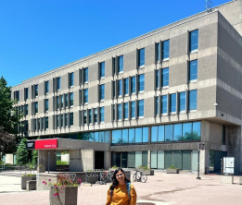
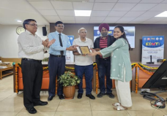
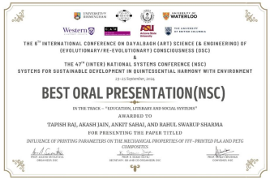
Department of Mechanical Engineering
Saloni Upadhyay, B.Tech. final year student pursued her Research Internship at the University of Guelph, Canada under the MITACS Global link research internship Programme offered by the Canadian Government.
Kanishka Pathik, B.Tech. final year student, presented research paper on “Comparative Study of Prediction Models on the Tensile Behaviour of Polymer Composites via Fused Filament Fabrication” in (ICDMT) 2024, Jointly organized by Punjab Engineering College (PEC), IIT Roorkee, and CSIR-Central Scientific Instruments Organization (November 8th – 10th).
Tapish Raj, PhD scholar of Mechanical Engineering department got the best paper award in 6th International Conference on Dayalbagh (Art) Science (& Engineering) of (Evolutionary/Re-Evolutionary) Consciousness (DSC) & the 47th (Inter) National Systems Conference (NSC ), September 23-25, 2024, paper titled “Influence of Printing Parameters on the Mechanical Properties of FFF-Printed PLA and PETG Composites”.

Slide 2
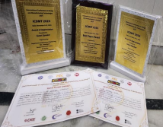
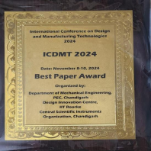
Kanishka Pathik , B.Tech. final year student, received Best Paper Award at International Conference on Design and Manufacturing Technologies (ICDMT) 2024, Jointly organized by Punjab Engineering College (PEC), IIT Roorkee, and CSIR-Central Scientific Instruments Organization (November 8th – 10th).

